Slide 1

C.F.W. Walther
Life, and intro to Law and Gospel

Slide 2

Who is he?
Lutheran theologian, born 1811, died 1887
Emigrated from Germany
First president of the Lutheran Church – Missouri Synod
Missouri’s most influential theologian
“Father of American Lutheranism”
Most influential work: The Proper Distinction Between Law and Gospel
Notes:
was the first President of the Lutheran Church - Missouri Synod and its most influential theologian.

Slide 3
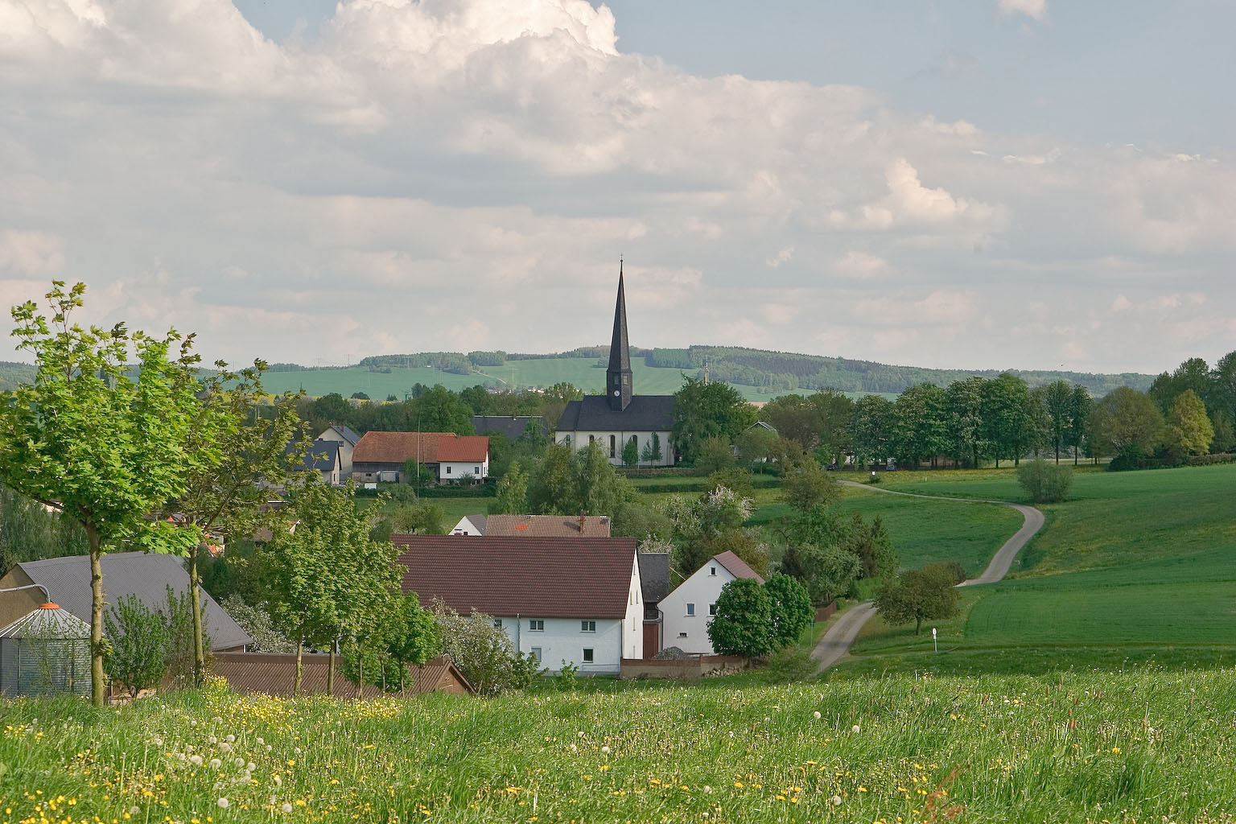
Notes:
Carl Ferdinand Wilhelm Walther was born on October 20, 1811 in Langenchursdorf, Saxony. He was the eighth child of Pastor Gottlieb Heinrich and Johanna Wilhelmina Walther.
Walther’s parents were faithful Christians and desired the same for their children. Carl Ferdinand, however, was sent away from home at a very early age to be educated at Schneeburg.

Slide 4

Notes:
Walther’s early education did so little to establish in him the basic teachings of God’s Word that by the time he was 18, he “did not know the Ten Commandments by heart and could not recite the list of the books in the Bible” (Walther, Law and Gospel, 141).

Slide 5
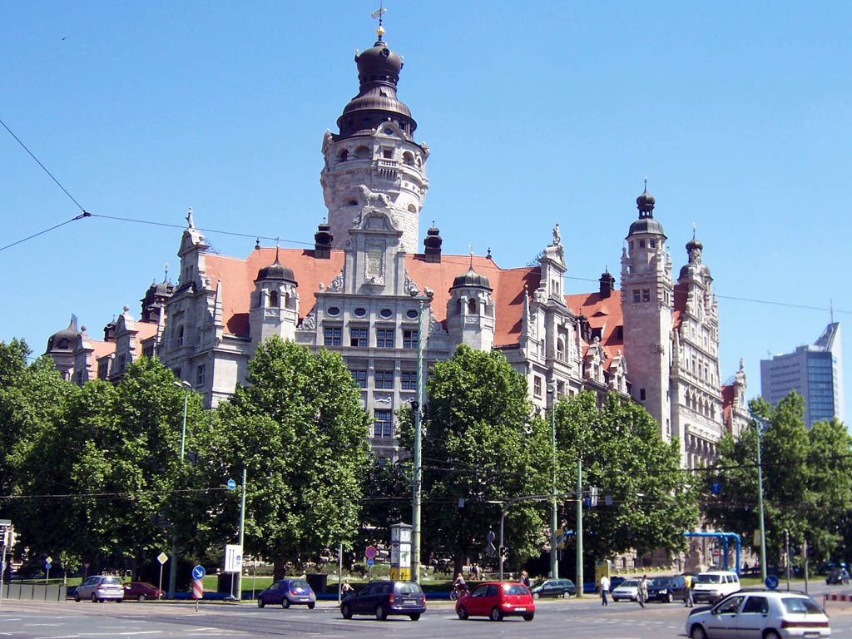
Notes:
Nevertheless, prompted by his father, Walther “entered the University of Leipzig on November 21, 1829 as a student of theology. He did not even own a Bible. This was acceptable at the University of Leipzig because Saxony was in the grips of German rationalism” (Reckzin, 10). “Rationalism” and “unbelief” are basically synonyms. Walther’s professors, almost to a man, had forsaken God’s Word and had told their students to do the same.

Slide 6
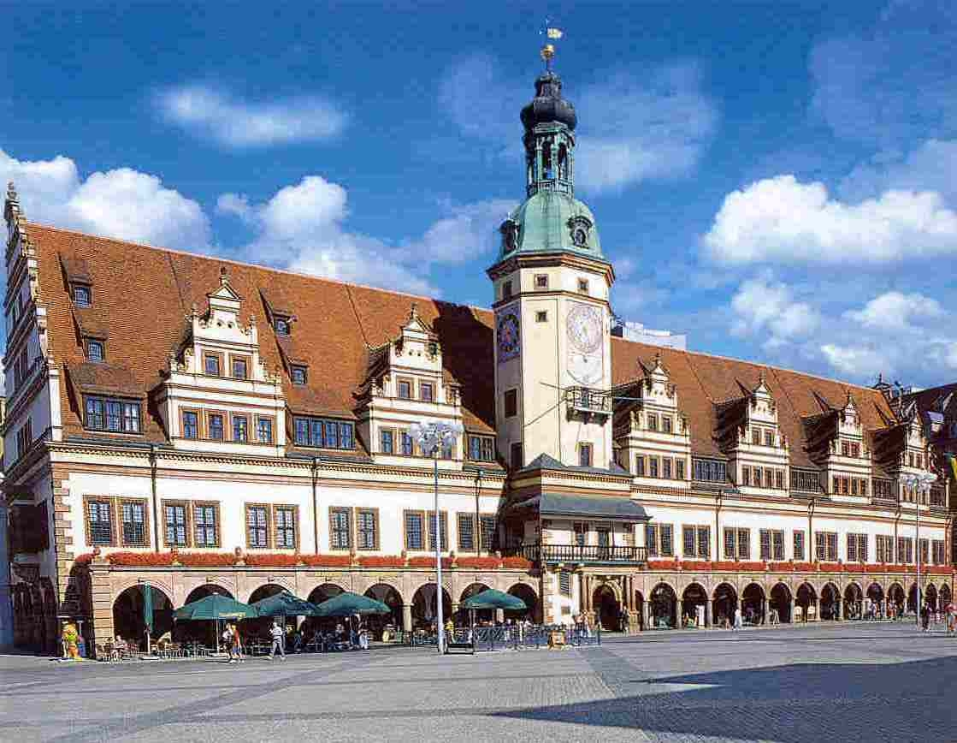
Notes:
God, in his great mercy, preserved a very small remnant of students at Leipzig who “had come to faith in the divine authorship of the Holy Scriptures and in the grace of God in Christ” (Suelflow, 23). Walther’s older brother, Otto Hermann, introduced him to these Christians. The group, which Walther quickly became a part of, gathered together several times a week to pray and to read God’s Word. Walther later recalled, “It was there that God began to work on my soul by means of his Word. In a short time I had really become a child of God, a believer, who trusted in His grace” (Law and Gospel, 141).
Not long after the light of the Gospel had broken through the darkness of Walther’s life, Satan tried to cloud and cover it up again. A new student of theology entered the group and, although he meant well, threw them into spiritual confusion. He said, “You imagine that you are converted Christians, don’t you? But you are not. You have not passed through any real penitential agony” (142). Because of this man’s teachings, Walther thought that he had to pray and struggle against sin until he came to the assurance that his sins had been forgiven. He became frustrated and was thrown into despair.

Slide 7
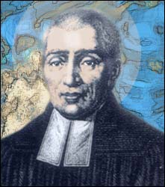
Martin Stephan
Notes:
Martin Stephan, a pastor from Dresden, comforted Walther and assured him of his salvation by pointing him to Jesus and his saving work. “Stephan showed him that the repentance which he was seeking was on the basis of the law, and he had already experienced it; that he was lacking nothing but faith” (Suelflow, 25).

Slide 8
“Everything has already been done; you are already redeemed; you have already been made righteous before God; you have already been saved. You therefore do not have to do anything to redeem yourself; you do not have to reconcile God to yourself; you do not have to earn your salvation. Only believe that Christ, the Son of God has done all this in your stead; and by means of this faith you are a participant in this salvation… In that the Lutheran Church ascribes the reconciliation and redemption of all men to God alone, and totally denies man’s participation or cooperation in this, it also in this teaching gives all glory to God alone” -C.F.W. Walther
Notes:
Throughout the early and mid-1830’s he read God’s Word, the Symbolic books of the Lutheran Church and Luther’s writings. He became convinced that salvation is a gift of God. Man deserves no credit for his salvation. All glory is given to God, because he has accomplished our salvation for us.

Slide 9
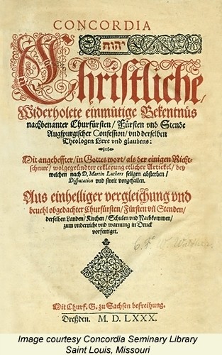
Notes:
Through intense study he became convinced that the Symbolic writings of the Lutheran Church (the Three Ecumenical Creeds, the Augsburg Confession and its Apology, the Smalcald Articles, a Treatise on the Power and Primacy of the Pope, The Large and Small Catechisms of Dr. Martin Luther, and the Formula of Concord) are a correct explanation of what the Bible says. He once wrote, “The Evangelical Lutheran Church is sure that the doctrine set forth in its Confessions [the Lutheran Symbols mentioned above] is the pure divine truth, because it agrees with the written Word of God on all points” (The True Visible Church, 121). A very bold statement! Every candidate for the public ministry in the Lutheran Church must thoroughly study the Lutheran Symbols to find out if the doctrine set forth in them agrees with the Scriptures.

Slide 10
“The Bible is the question of God to men: Do you believe My Word? The symbolical writings are the answer of men: Yes, Lord, We believe what you say! The Bible with its teachings is the handwriting of God concerning our salvation, which Satan always wishes to falsify and declare as unauthentic. The symbolical writings contain the records which have been laid down, from which one can see how the church has believed these teachings from time to time and has ever held fast to them” -C.F.W. Walther
Notes:
For Walther, the Bible was “the only source of our religious or theological knowledge… the only rule and plum line according to which all doctrines and teachers are to be judged and evaluated, as well as the only judge of all doctrinal controversies” (Suelflow, 175). In regard to the relationship between the Bible and the Lutheran Symbols, Walther said…

Slide 11
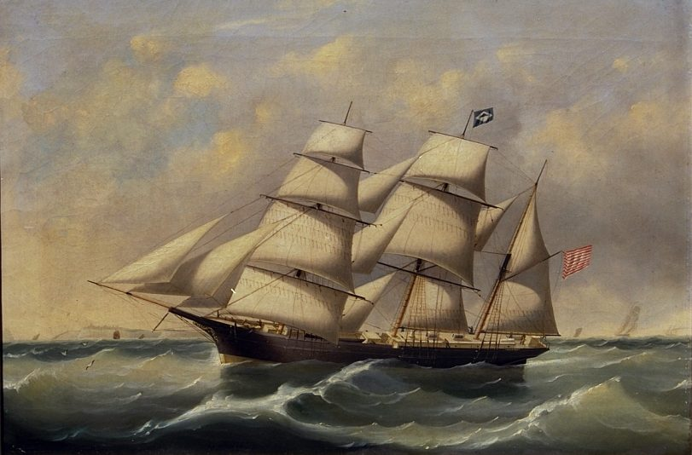
Notes:
After serving as a pastor briefly in Braeunsdorf, Walther immigrated to America with some of his fellow Saxons. On January 5, 1839, his ship arrived in New Orleans.
A few weeks later his group traveled up the Mississippi River and settled in St. Louis. They immediately began to form Christian congregations.

Slide 12
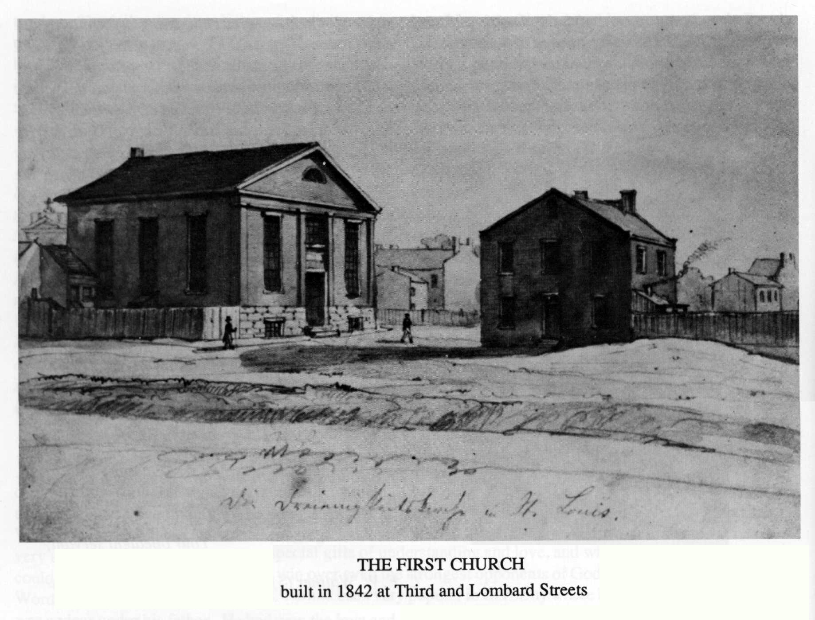
Notes:
On April 26, 1841, Walther accepted a divine call to Trinity congregation in St. Louis.

Slide 13
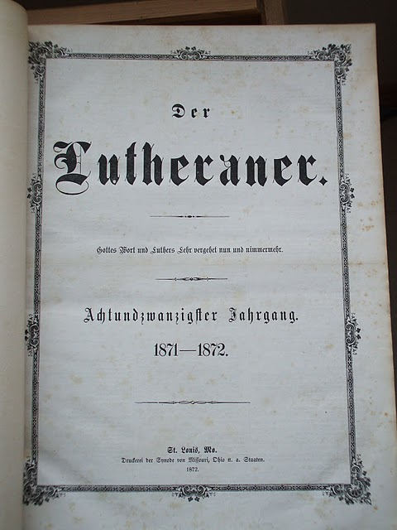
Notes:
The congregation supported the publication of a Lutheran newspaper, edited by Walther, called Der Lutheraner. The newspaper helped to unite Walther and his Saxon congregation with other Lutheran immigrants. Hochstetter said that, “Walther’s Der Lutheraner was like a great trumpet call. Its motto was ‘God’s Word and Luther’s doctrine will never disappear’” (Suelflow, 123).

Slide 14

Notes:
In May, 1846, some pastors who had recently separated from the Ohio Synod and had read about Walther’s theology in Der Lutheraner, traveled to Missouri for a meeting with Walther’s Saxons.
This meeting was the beginning of the Lutheran Church- Missouri Synod (LCMS). God blessed this church body with both doctrinal purity and numerical growth. In 1872, the Missouri Synod joined with the Ohio, Norwegian, Illinois, Minnestota, and Wisconsin Synods to form the Synodical Conference. Walther was overjoyed with how richly God had blessed him and the church body that he helped found.

Slide 15
Election Controversy
Why did God choose some individuals out of the mass of equally sinful human beings to have everlasting life in heaven?
The answer is grace, God’s undeserved love for sinners because of Christ.
Notes:
His life, however, was also filled with grief and trial. His greatest hardship as the chief theologian of the Missouri Synod came in the form of the Election Controversy.
The doctrine of election teaches that “God according to his purpose in Christ and according to his providence has elected certain persons out of the multitude of all the lost so that they are to obtain eternal life, he then also brings these elect to faith and keeps them in faith unto the end” (Hoenecke,Evangelical Lutheran Dogmatics, vol. 3, p.17). The question at the heart of the Predestination Controversy of the late 1870’s and early 1880’s was this: Why did God choose some individuals out of the mass of equally sinful human beings to have everlasting life in heaven? The answer is grace, God’s undeserved love for sinners because of Christ.

Slide 16
Election
“We believe, teach, and confess, that the cause which moved God to elect, is alone His grace and the merit of Jesus Christ, and not anything good foreseen by God in the elect, not even faith foreseen in them by God”
(Concerning the opponents): “Turn and twist as much as they will, they declare that something which man does is the cause of his salvation”
Notes:
Walther, compelled to defend the Scriptural doctrine of the election of grace, condemned the position of the F.A. Schmidt and the Ohio Synod (intuitu fidei) when he wrote on behalf of the Synodical Conference: “We believe, teach, and confess, that the cause which moved God to elect, is alone His grace and the merit of Jesus Christ, and not anything good foreseen by God in the elect, not even faith foreseen in them by God” (Moving Frontiers, 273). Walther later said of his opponents in this controversy: “Turn and twist as much as they will, they declare that something which man does is the cause of his salvation” (Law and Gospel, 271).

Slide 17
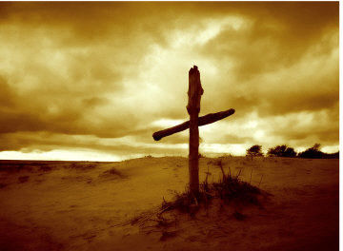
Notes:
With this and many other troubles, God fashioned C.F.W. Walther into a theologian of the cross. “We must go through many hardships to enter the kingdom of God” (Acts 14:22). Walther learned that lesson again and again. He once wrote, “We also know that when God lays a cross on us, this is not his anger, but rather a sign of His love… We are thereby to become like the picture of the Son of God Himself, who never laughed but wept much in this vale of tears” (Suelflow, 252).

Slide 18
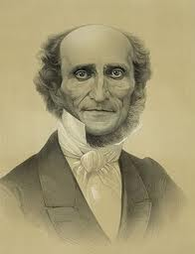
Notes:
God also blessed Walther with many joys in this life. On September 21, 1841, Walther married Emilie Buenger. Theirs was a very happy marriage and was certainly a marriage in Christ. Walther also dearly loved his children. Walther described the joy he felt when his first daughter (Magdalene) was born: “It was nothing less than if I had won the grand prize. I would not have given up this treasure for anything in the world. Now when I went out of the house, it seemed to me as if I had a magnet at home that continually drew me homeward” (Suelflow, 242).

Slide 19
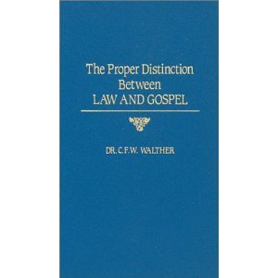
Notes:
Walther’s greatest contribution to Lutheran theology was his evening lectures on “The Proper Distinction Between Law and Gospel.” These lectures are considered one of the great works of American Lutheranism.

Slide 20
The Proper Distinction Between Law and Gospel
Friday night lectures to seminary students
Delivered between 1884-1885
25 theses
39 Evening Lectures

Slide 21
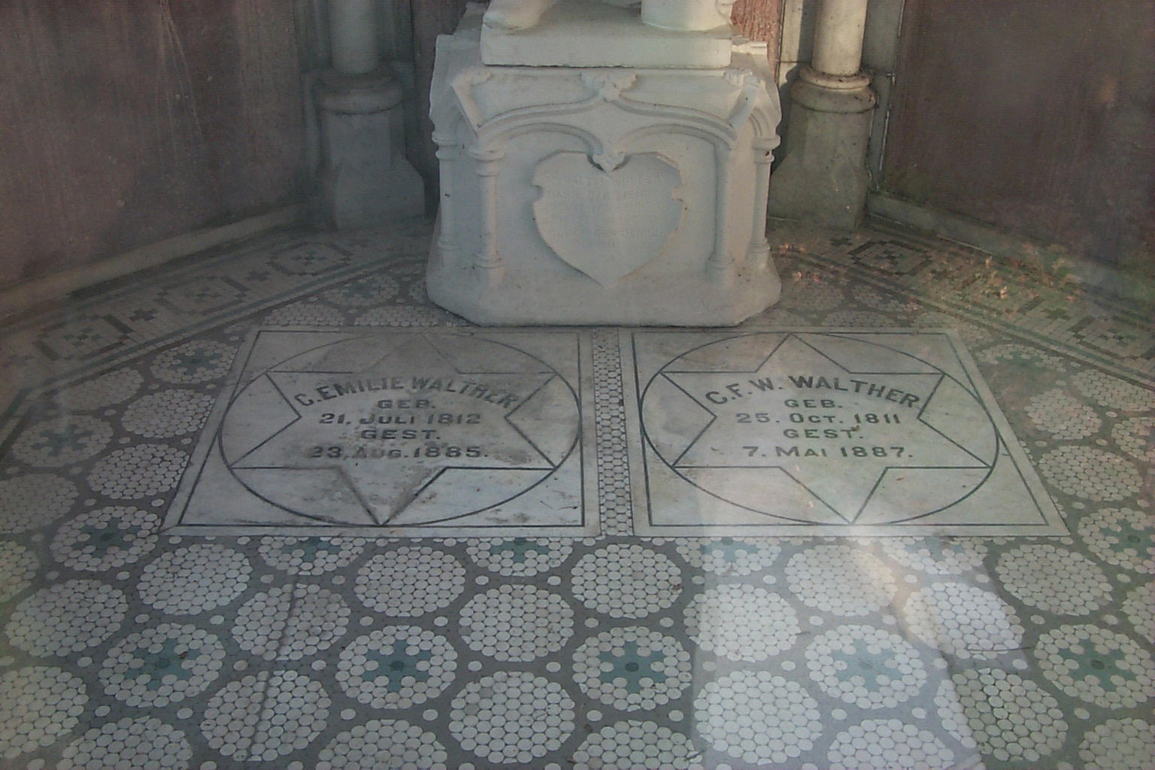
Notes:
He wrote many other books and convention essays. Dr. August R. Suelflow wrote a fascinating biography of Walther, which supplied most of the information for this biography.
Reflecting on his life Walther declared, “I have received a lot of praise as well as much criticism during my life, but you can believe, my dear brothers, that I have become immune to them. Thank and praise God for the great deeds He has done.”
Dr. C.F.W. Walther was taken to heaven on May 17, 1887. He is buried in a mausoleum in Concordia Cemetery, St. Louis.

